Slide 1
Class 3 – Threads & Concurrency
Osama Hosam
Taiba University

Slide 2
Threads

Slide 3
Threads
Processes have the following components:
  an address space
  a collection of operating system state
  a CPU context … or thread of control
On multiprocessor systems, with several CPUs, it would make sense for a process to have several CPU contexts (threads of control)
  Thread fork creates new thread not memory space
  Multiple threads of control could run in the same memory space on a single CPU system too!
Notes:
Context switching between thread is cheaper… ASK WHY?
Because you don’t have O.S. to change.

Slide 4
Threads
Threads share a process address space with zero or more other threads
Threads have their own
  PC, SP, register state, stack
A traditional process can be viewed as a memory address space with a single thread
Notes:
Context switching between thread is cheaper… ASK WHY?
Because you don’t have O.S. to change.

Slide 5
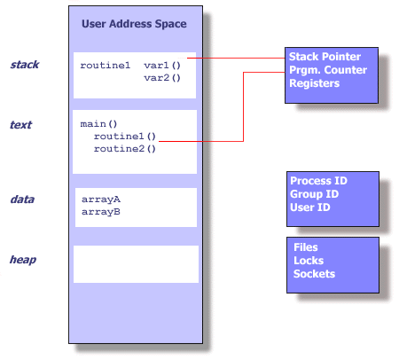
Single thread state within a process

Slide 6
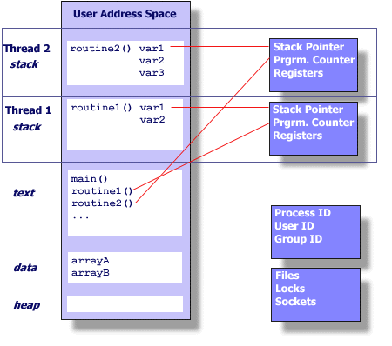
Multiple threads in an address space

Slide 7
What is a thread?
A thread executes a stream of instructions
  it is an abstraction for control-flow
Practically, it is a processor context and stack
  Allocated a CPU by a scheduler
  Executes in the context of a memory address space

Slide 8
Summary of private per-thread state
Things that define the state of a particular flow of control in an executing program:
  Stack (local variables)
  Stack pointer
  Registers
  Scheduling properties (i.e., priority)

Slide 9
Shared state among threads
Things that relate to an instance of an executing program (that may have multiple threads)
  User ID, group ID, process ID
  Address space
    Text
    Data (off-stack global variables)
    Heap (dynamic data)
  Open files, sockets, locks
Important: Changes made to shared state by one thread will be visible to the others
  Reading and writing memory locations requires synchronization! … a major topic for later …

Slide 10
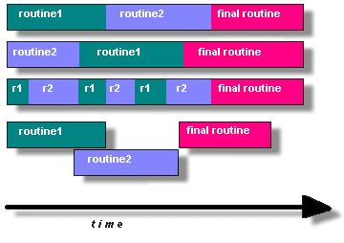
How do you program using threads?
Split program into routines to execute in parallel
  True or pseudo (interleaved) parallelism
Alternative
strategies for
executing multiple
rountines

Slide 11
Why program using threads?
Utilize multiple CPU’s concurrently
Low cost communication via shared memory
Overlap computation and blocking on a single CPU
  Blocking due to I/O
  Computation and communication
Handle asynchronous events

Slide 12
Processes versus threads - example
A WWW process
HTTPD
GET / HTTP/1.0
disk

Slide 13
Processes versus threads - example
A WWW process
HTTPD
GET / HTTP/1.0
disk
Why is this not a good web server design?

Slide 14
Processes versus threads - example
A WWW process
HTTPD
HTTPD
GET / HTTP/1.0
disk

Slide 15
Processes versus threads - example
A WWW process
HTTPD
GET / HTTP/1.0
GET / HTTP/1.0
disk

Slide 16
Processes versus threads - example
A WWW process
HTTPD
GET / HTTP/1.0
GET / HTTP/1.0
GET / HTTP/1.0
disk
GET / HTTP/1.0

Slide 17

Threads in a web server
A multithreaded web server

Slide 18
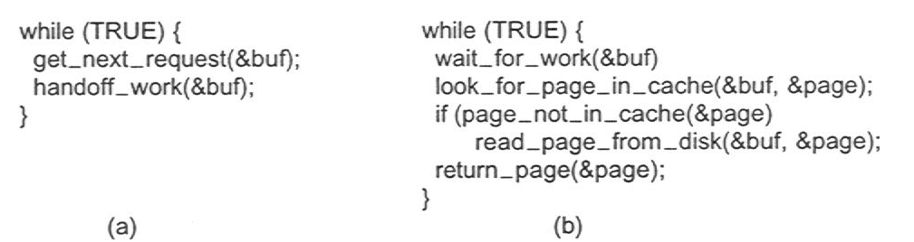
Thread usage
Rough outline of code for previous slide
  (a) Dispatcher thread
  (b) Worker thread

Slide 19
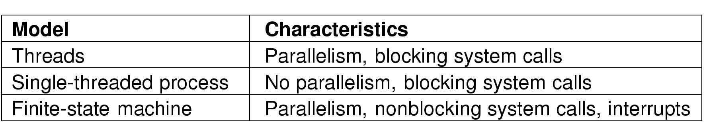
System structuring options
Three ways to construct a server

Slide 20
Common thread programming models
Manager/worker
  Manager thread handles I/O and assigns work to worker threads
  Worker threads may be created dynamically, or allocated from a thread-pool
Pipeline
  Each thread handles a different stage of an assembly line
  Threads hand work off to each other in a producer-consumer relationship

Slide 21
What does a typical thread API look like?
POSIX standard threads (Pthreads)
First thread exists in main(), typically creates the others
pthread_create (thread,attr,start_routine,arg)
  Returns new thread ID in “thread”
  Executes routine specified by “start_routine” with argument specified by “arg”
  Exits on return from routine or when told explicitly

Slide 22
Thread API (continued)
pthread_exit (status)
  Terminates the thread and returns “status” to any joining thread
pthread_join (threadid,status)
  Blocks the calling thread until thread specified by “threadid” terminates
  Return status from pthread_exit is passed in “status”
  One way of synchronizing between threads
pthread_yield ()
  Thread gives up the CPU and enters the run queue

Slide 23
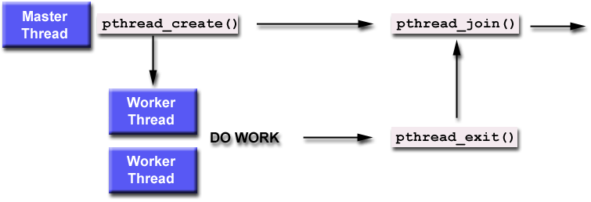
Using create, join and exit primitives

Slide 24
An example Pthreads program
#include <pthread.h>
#include <stdio.h>
#define NUM_THREADS 5
void *PrintHello(void *threadid)
{
printf("\n%d: Hello World!\n", threadid);
pthread_exit(NULL);
}
int main (int argc, char *argv[])
{
pthread_t threads[NUM_THREADS];
int rc, t;
for(t=0; t<NUM_THREADS; t++)
{
printf("Creating thread %d\n", t);
rc = pthread_create(&threads[t], NULL, PrintHello, (void *)t);
if (rc)
{
printf("ERROR; return code from pthread_create() is %d\n", rc);
exit(-1);
}
}
pthread_exit(NULL);
}
Program Output
Creating thread 0
Creating thread 1
0: Hello World!
1: Hello World!
Creating thread 2
Creating thread 3
2: Hello World!
3: Hello World!
Creating thread 4
4: Hello World!
For more examples see: http://www.llnl.gov/computing/tutorials/pthreads

Slide 25
Pros & cons of threads
Pros
  Overlap I/O with computation!
  Cheaper context switches
  Better mapping to shared memory multiprocessors
Cons
  Potential thread interactions
  Complexity of debugging
  Complexity of multi-threaded programming
  Backwards compatibility with existing code
Notes:
Context switching between thread is cheaper… ASK WHY?
Because you don’t have O.S. to change.

Slide 26
User-level threads
The idea of managing multiple abstract program counters above a single real one can be implemented using privileged or non-privileged code.
  Threads can be implemented in the OS or at user level
User level thread implementations
  thread scheduler runs as user code (thread library)
  manages thread contexts in user space
  The underlying OS sees only a traditional process above

Slide 27
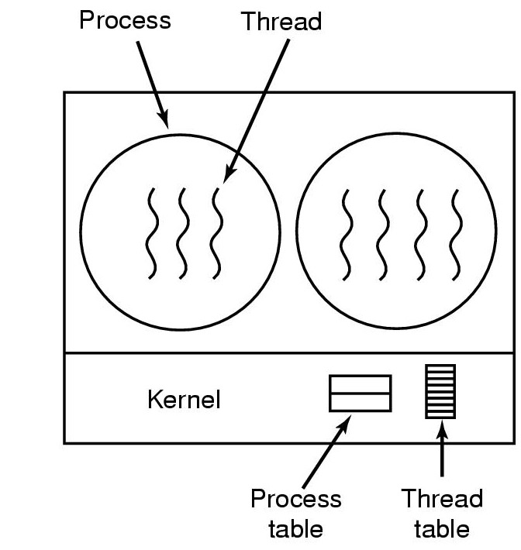
Kernel-level threads
The thread-switching code is in the kernel

Slide 28
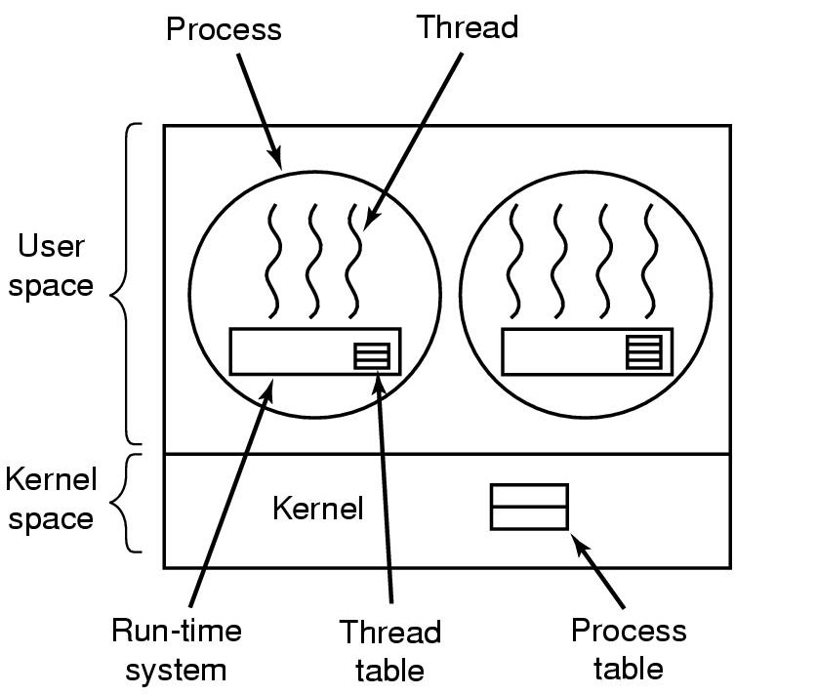
User-level threads package
The thread-switching code is in user space

Slide 29
User-level threads
Advantages
  cheap context switch costs among threads in the same process!
    A procedure call not a system call!
  User-programmable scheduling policy
Disadvantages
  How to deal with blocking system calls!
  How to overlap I/O and computation!

Slide 30
Concurrent Programming

Slide 31
Concurrent programming
Assumptions:
  Two or more threads
  Each executes in (pseudo) parallel
  We can’t predict exact running speeds
  The threads can interact via access to shared variables
Example:
  One thread writes a variable
  The other thread reads from the same variable
  Problem – non-determinism:
    The relative order of one thread’s reads and the other thread’s writes determines the end result!

Slide 32
Race conditions
What is a race condition?
  two or more threads have an inconsistent view of a shared memory region (I.e., a variable)
Why do race conditions occur?
  values of memory locations replicated in registers during execution
  context switches at arbitrary times during execution
  threads can see “stale” memory values in registers

Slide 33

Counter increment race condition
Incrementing a counter (load, increment, store)
Context switch can occur after load and before increment!

Slide 34
Race Conditions
Race condition: whenever the output depends on the precise execution order of the processes!
What solutions can we apply?
  prevent context switches by preventing interrupts
  make threads coordinate with each other to ensure mutual exclusion in accessing critical sections of code

Slide 35
Mutual exclusion conditions
No two processes simultaneously in critical section
No assumptions made about speeds or numbers of CPUs
No process running outside its critical section may block another process
No process must wait forever to enter its critical section

Slide 36

Critical sections with mutual exclusion

Slide 37
How can we enforce mutual exclusion?
What about using locks ?
Locks solve the problem of exclusive access to shared data.
  Acquiring a lock prevents concurrent access
  Expresses intention to enter critical section
Assumption:
  Each each shared data item has an associated lock
  Every thread sets the right lock before accessing shared data!
  Every thread releases the lock after it is done!

Slide 38

Acquiring and releasing locks
Thread B
Thread C
Thread A
Thread D
Free
Lock

Slide 39
Acquiring and releasing locks
Thread B
Thread C
Thread A
Lock
Thread D
Free
Lock

Slide 40
Acquiring and releasing locks
Thread B
Thread C
Thread A
Lock
Thread D
Set
Lock

Slide 41
Acquiring and releasing locks
Thread B
Thread C
Thread A
Lock
Thread D
Set
Lock

Slide 42
Acquiring and releasing locks
Thread B
Thread C
Thread A
Thread D
Set
Lock

Slide 43
Acquiring and releasing locks
Thread B
Thread C
Thread A
Lock
Thread D
Set
Lock

Slide 44
Acquiring and releasing locks
Thread B
Thread C
Thread A
Lock
Thread D
Set
Lock

Slide 45
Acquiring and releasing locks
Thread B
Thread C
Thread A
Lock
Lock
Thread D
Lock
Set
Lock

Slide 46
Acquiring and releasing locks
Thread B
Thread C
Thread A
Lock
Lock
Thread D
Lock
Set
Lock

Slide 47
Acquiring and releasing locks
Thread B
Thread C
Thread A
Lock
Lock
Unlock
Thread D
Lock
Set
Lock

Slide 48
Acquiring and releasing locks
Thread B
Thread C
Thread A
Lock
Lock
Unlock
Thread D
Lock
Set
Lock

Slide 49
Acquiring and releasing locks
Thread B
Thread C
Thread A
Lock
Lock
Thread D
Lock
Free
Lock

Slide 50
Acquiring and releasing locks
Thread B
Thread C
Thread A
Lock
Lock
Thread D
Lock
Free
Lock

Slide 51
Acquiring and releasing locks
Thread B
Thread C
Thread A
Lock
Lock
Thread D
Lock
Set
Lock

Slide 52
Acquiring and releasing locks
Thread B
Thread C
Thread A
Lock
Lock
Thread D
Lock
Set
Lock

Slide 53
Acquiring and releasing locks
Thread B
Thread C
Thread A
Lock
Thread D
Lock
Set
Lock

Slide 54
Mutex locks
An abstract data type
Used for synchronization and mutual exclusion
The mutex is either:
  Locked (“the lock is held”)
  Unlocked (“the lock is free”)

Slide 55
Mutex lock operations
Lock (mutex)
  Acquire the lock if it is free
  Otherwise wait until it can be acquired
Unlock (mutex)
  Release the lock
  If there are waiting threads wake up one of them

Slide 56
How to use a mutex?
Shared data:
Mutex myLock;
1 repeat
2 Lock(myLock);
3 critical section
4 Unlock(myLock);
5 remainder section
6 until FALSE
1 repeat
2 Lock(myLock);
3 critical section
4 Unlock(myLock);
5 remainder section
6 until FALSE

Slide 57
How to implement a mutex?
Both Lock and Unlock must be atomic !
  Does a binary “lock” variable in memory work?
Many computers have some limited hardware support for setting locks
  Atomic Test and Set Lock instruction
  Atomic compare and swap operation
Can be used to implement mutex locks

Slide 58
Test-and-set-lock instruction (TSL, tset)
A lock is a single word variable with two values
  0 = FALSE = not locked
  1 = TRUE = locked
Test-and-set does the following atomically:
  Get the (old) value
  Set the lock to TRUE
  Return the old value
  If the returned value was FALSE...
    Then you got the lock!!!
  If the returned value was TRUE...
    Then someone else has the lock
  (so try again later)

Slide 59
Test and set lock
P1
FALSE
Lock

Slide 60
Test and set lock
FALSE = Lock Available!!
P1
FALSE
Lock

Slide 61
Test and set lock
P1
FALSE
TRUE
Lock

Slide 62
Test and set lock
P1
P2
P3
TRUE
TRUE
TRUE
TRUE
TRUE
P4
TRUE
TRUE
Lock

Slide 63
Test and set lock
P1
P2
P3
TRUE
TRUE
TRUE
TRUE
TRUE
P4
TRUE
TRUE
Lock

Slide 64
Test and set lock
P1
P2
P3
TRUE
TRUE
TRUE
TRUE
TRUE
P4
TRUE
TRUE
Lock

Slide 65
Test and set lock
P1
P2
P3
FALSE
TRUE
P4
FALSE
Lock

Slide 66
Test and set lock
P1
P2
P3
FALSE
TRUE
TRUE
P4
TRUE
Lock

Slide 67
Test and set lock
P1
P2
P3
FALSE
TRUE
P4
TRUE
Lock

Slide 68
Test and set lock
P1
P2
P3
TRUE
TRUE
TRUE
P4
TRUE
TRUE
Lock

Slide 69
Critical section entry code with TSL
I
J
1 repeat
2 while(TSL(lock))
3 no-op;
4 critical section
5 Lock = FALSE;
6 remainder section
7 until FALSE
1 repeat
while(TSL(lock))
3 no-op;
4 critical section
5 Lock = FALSE;
6 remainder section
7 until FALSE
Guarantees that only one thread at a time will enter its critical section
Note that processes are busy while waiting
  Spin locks

Slide 70
Busy waiting
Also called polling or spinning
  The thread consumes CPU cycles to evaluate when the lock becomes free !
Shortcoming on a single CPU system...
  A busy-waiting thread can prevent the lock holder from running & completing its critical section & releasing the lock!
  Why not block instead of busy wait ?

Slide 71
Quiz
What is the difference between a program and a process?
Is the Operating System a program?
Is the Operating System a process?
  Does it have a process control block?
  How is its state managed when it is not running?
What is the difference between processes and threads?
What tasks are involved in switching the CPU from one process to another?
  Why is it called a context switch?
What tasks are involved in switching the CPU from one thread to another?
  Why are threads “lightweight”?

